Slide 1



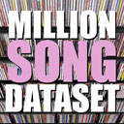


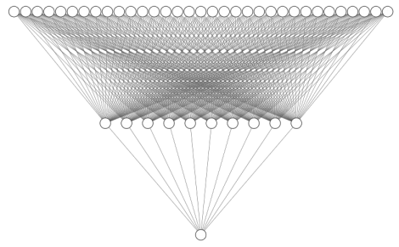

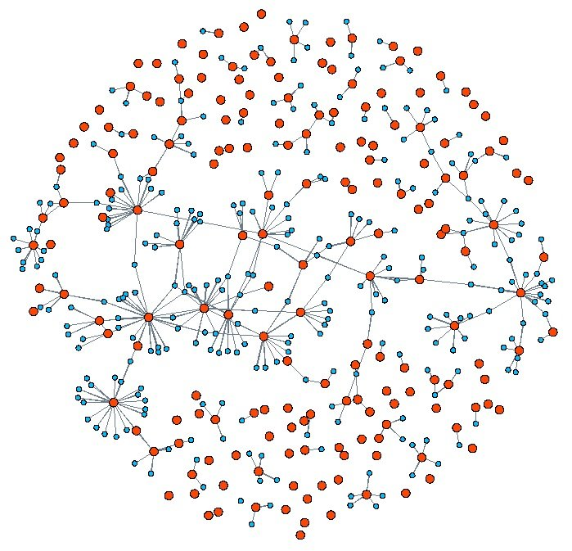
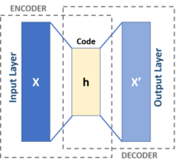
Improving Hit Song Prediction Networks with Musician Co-Collaboration Network Data
Data Sources
High-Level Acoustic Data
or
0.5, 0.72, 0.82, 0.99…
Song Collaborator Data
Hit Prediction
Feature Vectors for Music Industry Collaborators
Hit Predictor Neural Network
Music Industry Social Network
Graph Autoencoder

